Slide 1


“Detection of Phishing Website Using Machine Learning”
Sinhgad Academy of Engineering Department of Information Technology
Presented by
Faheem Shaikh 17
Pooja Garg 14
Kunal Rokde 16
Omkar Shelke 19
Under Guidance of
Prof. A.N.Varade

Slide 2
PROBLEM STATEMENT
Phishing is an online crime that tries to trick unsuspected users to expose their sensitive (and valuable) personal information, for example, usernames, passwords, financial account details, personal addresses, SSN, and social relationships, to the miscreant, often for malicious reasons. Phishing is normally perpetrated by disguising as a trustworthy entity in internet communication which is achieved by combining both social engineering and technical tricks.

Slide 3
PURPOSE AND OBJECTIVE
To determine the best classification algorithm for phishing detection.
To conduct a comparative assessment between various classification data mining algorithms techniques, and various feature selection scenarios.
To develop multi-classifier integration model by combining clustering and more than one classification technique to enhance detection and protecting phishing websites.

Slide 4
PROJECT SCOPE
The main purpose of the proposed system is to detect the phishing websites who are trying to get access to sensitive data or by creating the fake website and trying to get access of user’s personal credentials. We are using machine learning algorithm to safeguard the sensitive data and detect the phishing website who are trying to gain access on sensitive data.

Slide 5
Literature Survey
Sr. No | Author | Year | Title | Technique
1 | Vaibhav Patil and Pritesh Thakkar | 2018 | Detection and Prevention of Phishing Websites using Machine Learning Approach | Proposed three approaches for detecting phishing websites. First is by analyzing various features of URL , second is by checking legitimacy of website by knowing where the website is being hosted and who are managing it.
2 | Charu Singh | 2020 | Phishing Website Detection Based on Machine Learning: A Survey | Review was made With the huge number of phishing emails or messages received every day, companies or individuals are not able to detect all of them, where different reviews were given for detection of phishing attack, by using machine learning.
3 | Mehmet Korkmaz and Ozgur Koray Sahingoz | 2020 | Detection of Phishing Websites by Using Machine Learning-Based URL Analysis | Proposed a machine learning-based phishing detection system by using eight different algorithms to analyze the URLs, and three different datasets to compare the results with other works.

Slide 6
Literature Survey
Sr. No | Author | Year | Title | Technique
4 | Jitendra Kumar and A. Santhanavijayan | 2020 | Phishing Website Classification and Detection Using Machine Learning | logistic regression , Gaussian Naïve Bayes and Random Forest
5 | A. Lakshmanarao and P.Surya Prabhakara Rao | 2021 | Phishing website detection using novel machine learning fusion approach | various machine learning algorithms logistic regression, decision tree classifier, random forest classifier, AdaBoost, gradient boosting classifier for the phishing detection

Slide 7
SYSTEM OVERVIEW
The proposed approach aims at building a system for detecting phishing websites using machine learning. Furthermore, given the flexibility of margin and reduced computational complexity offered by SVM, for classification problem statements, the implementation employs SVM trained persistent model to identify the malicious sites.
The data set is collected and divided into 2 parts i.e 80% for training and rest 20% for testing purpose.
URL based and Text based Data set is used . Further these datasets are been passed under some techniques like preprocessing , feature extraction and classification by using Support vector machine to train a model. The user input and model are later on compared and depending on the feature matching perdition occurs.

Slide 8
Algorithm Proposed (SVM, KNN, RF)
Support Vector Machine : -
A support vector machine (SVM) is a supervised machine learning algorithm that can be used for both classification and regression purposes. SVM are mostly used in classification problems.
SVM are founded on the idea of finding a hyperplane that best divides a dataset into two classes. Support vectors are the data points nearest to the hyperplane, the points of a data set that, if deleted, would alter the position of the dividing hyperplane.
Because of this, they can be considered the critical elements of a data set. The distance between the hyperplane and the nearest data point from either set is known as the margin.
The aim is to choose a hyperplane with the greatest possible margin between the hyperplane and any point within the training set, giving a higher chance of new data being classified correctly

Slide 9
Proposed Architecture
URL dataset
Text dataset
Pre-processing
Feature Extraction
Support Vector Machine Technique
Phishing
Legitimate
Classification
Fig :- System architecture

Slide 10
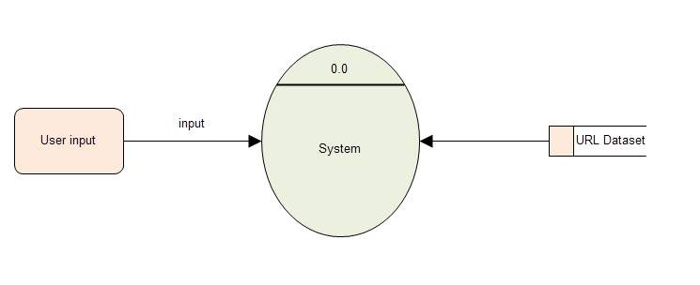
DFD Level 0 Diagram

Slide 11
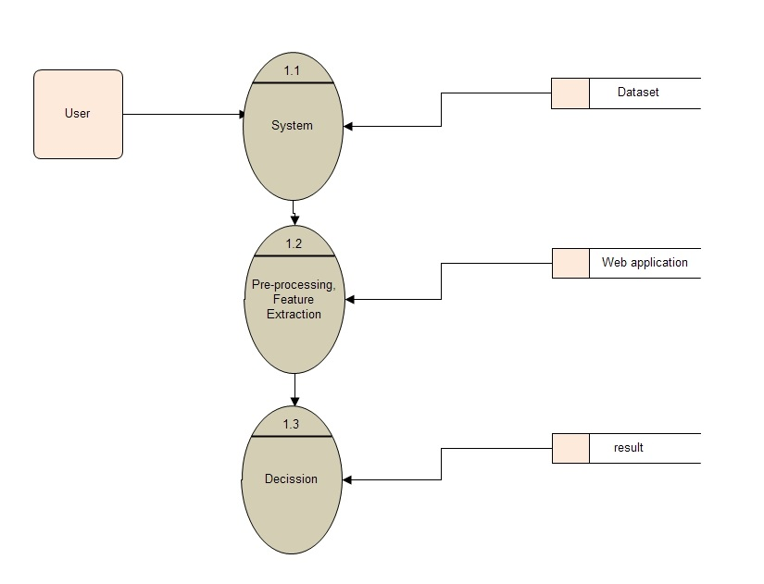
DFD Level 1 Diagram

Slide 12
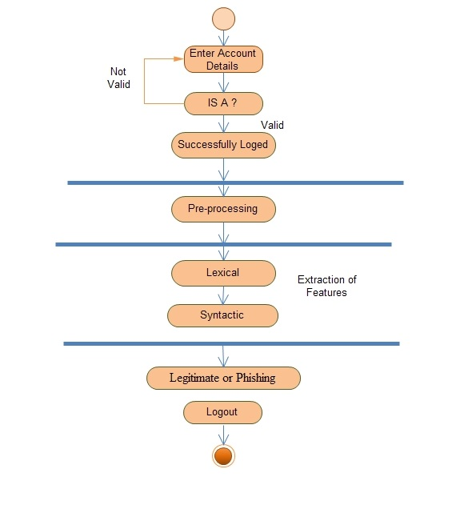
Activity Diagram

Slide 13
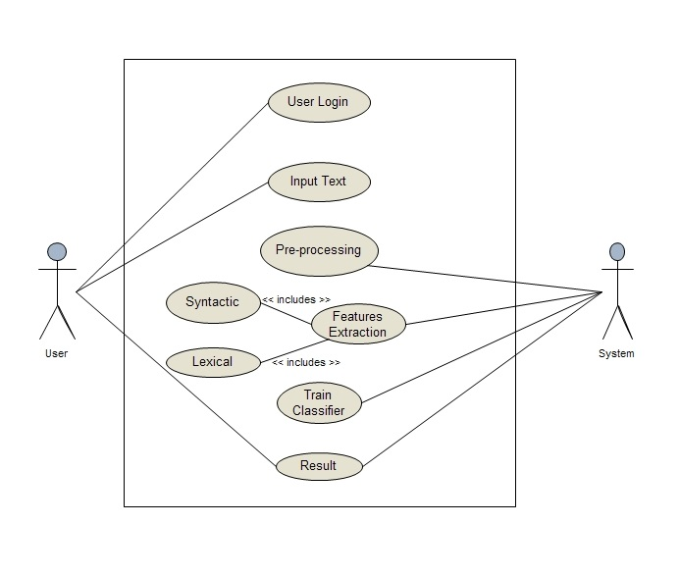
Usecase Diagram

Slide 14
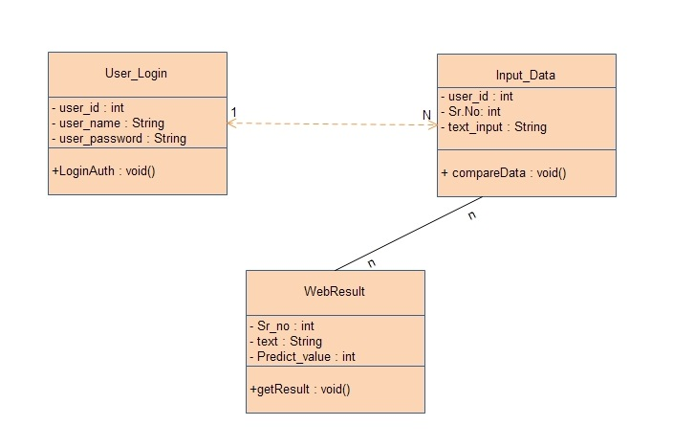
Class Diagram

Slide 15
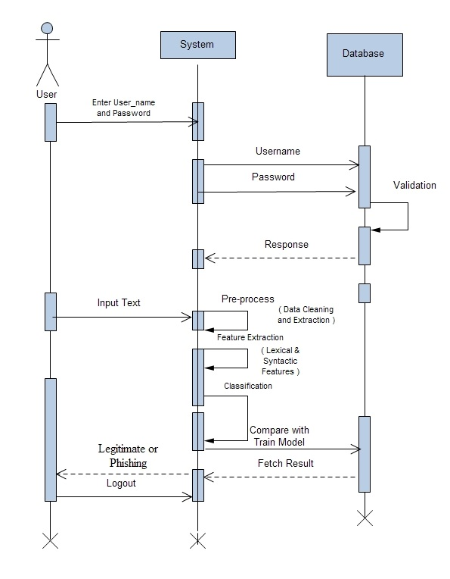
Sequence Diagram

Slide 16

Design Model
System
Decision
Design Model
Dataset
Preprocess
Extraction
Classification
Legitimate / phishing

Slide 17
HARDWARE REQUIREMENTS
Processor : Intel i3 minimum or more
Disk Space : At least 3GB for Python IDE
RAM : 4GB minimum or more

Slide 18
SOFTWARE REQUIREMENTS
Python
PHP
MySQL

Slide 19
SOFTWARE REQIUIREMENT SPECIFICATIONS (SRS)
Introduction:-
This software requirement specification (SRS) report expresses complete description about proposed System. This document includes all the functions and specifications with their explanations to solve related problems.
Purpose:-
The Purpose of the project is to develop a multi-classifier integration model by combining clustering and more than one classification technique to enhance detection and protecting phishing websites
Product Scope:-
It will be offline application & easy to use.
It can be used to detect the phishing websites who are trying to get access to sensitive data or by creating the fake website and trying to get access of user’s personal credentials

Slide 20
Conti…
Product Functions:-
Master module
Training Dataset
Testing Dataset
Search module
Input Links
User Classes and Characteristics
End Users
End user should have basic idea about computer operations and database.
No specific knowledge or skills are required from the end user.
Administrator
Administrator must be training the new dataset every time.
Administrator must be having good knowledge of dataset management system.

Slide 21
Assumptions and Dependencies
Assumptions:
The product must have an interface which is simple enough to understand.
All the software such as python, mysql, php are installed and running on the computers
Dependencies:
All necessary software’s are available for implementing and use of the system.
The proposed system would be designed, developed and implemented based on the software requirements specifications document.
End users should have basic knowledge of computer and we also assure that the users will be given software training documentation and reference material.
Well Trained dataset

Slide 22
High Level Design
Phishing URL
Preprocessing
80% Training Data
Dataset
Benign URL
20% Testing Data
Normalization and Feature Extraction
Model Training Using ML Techniques
Selection of Feature
Save Trained Model
Trained Model
Classification
Result
User input

Slide 23
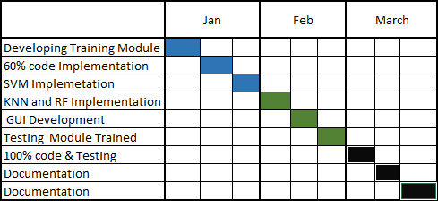
PROJECT PLAN 2.0

Slide 24
References
[1]. A. Lakshmanarao and P.Surya Prabhakara Rao, “Phishing website detection using novel machine learning fusion approach ”, IEEE 2021
[2]. Jitendra Kumar and A. Santhanavijayan , “Phishing Website Classification and Detection Using Machine Learning ”, International Conference on Computer Communication and Informatics, 2020
[3]. Mehmet Korkmaz and Ozgur Koray Sahingoz, “Detection of Phishing Websites by Using Machine Learning-Based URL Analysis”, IEEE 2020
[4]. Charu Singh , “Phishing Website Detection Based on Machine Learning: A Survey”,IEEE 2020
[5]. Vaibhav Patil and Pritesh Thakkar , “Detection and Prevention of Phishing Websites using Machine Learning Approach”, IEEE 2018

